Slide 1
Chapter 2 Emergence and Convergence of Technologies

Slide 2
Table of Contents
Introduction
Emergence
The Rise of Print Media
The Rise of the Telegraph and the Telephone
The Rise of Broadcast Media
The Rise of the Computing Industry
The Rise of the Content Industry
The Rise of the Internet

Slide 3
Table of Contents
Convergence
Content Producers and Distributors
Platform Producers and Content Producers or Publishers
Corporate Production vs Individual Creativity
Market Sector Integration, Horizontal and Vertical Integration
Digitization
The Big Challenges Ahead

Slide 4
Introduction
Many scholars now believe we are in the midst of the next phase change in human society: the ‘information revolution’.
This time, however, the revolution is happening much faster.
programmable digital computers: late 1940s
personal computers: 1970s
Internet: 1990s
The scale and pace of change in ‘information revolution’ has far outstripped that of the industrial revolution.

Slide 5
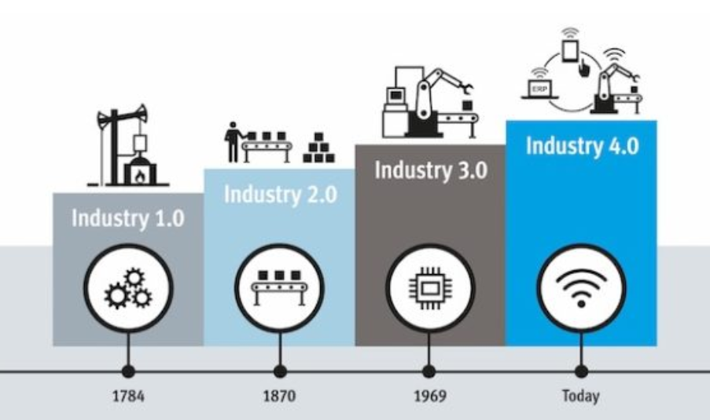
Cyber physical systems, horizontal integration, analytics using AI
Electronic and IT systems, automation
Mass production and electricity
Mechanization, stream and water power
Source: https://innonews.blog/2018/01/04/17-technologickych-oblasti-pre-rozvoj-industry-4-0/

Slide 6
Introduction
Generations in the industrialized world are much longer now: life spans are considerably longer.
This all leads to a constant requirement for the individual to cope with a greater many changes during a lifetime.

Slide 7
Introduction
Changes in information revolution:
Ex #1. Entertainment Media
VCR 🡪 DVD 🡪 BLURAY 🡪 CLOUD
Ex. #2 Communication
postal services 🡪 telegraph 🡪 telephone 🡪 e-mail 🡪 mobile phone 🡪 text message 🡪 chat room 🡪 instant messaging

Slide 8
EMERGENCE: THE RISE OF PRINT MEDIA

Slide 9


EMERGENCE: The Rise of Print Media
Mass production of copies of written work
Cheap and quick
Fast dissemination of ideas
Mass sales
Image source: Internet

Slide 10
EMERGENCE: The Rise of Print Media
Social changes:
Quick access to literature
Increase in literacy rates for mass sales 🡪 social policy conflict with the employers of unskilled and semi-skilled labour
Control of which information people may access comprises a large part of controlling those people. E.g. Catholic Church resisted interpretation of Bible.
Globalized society
Notes:
Literate workers are far more likely to organize on a wide scale, be aware of concepts of trade, economics, the value of labour and other ideas dangerous to the profits of factory owners.
Various groups (which had exerted control over others) had that control undermined by access to printed matter. When bibles were hand-copied in Latin, many did not know Latin and thus only priest interpret the bible. The availability of mass-produced bibles translated into local languages allowed ordinary members of the congregation to read the bible themselves and contest the interpretation of the priest.
Globalized society: cheap and easy printing allows for mass production of books, which allows for people in geographically distant places to achieve a similarity of experience which is otherwise unattainable. The ability for many people to read the same reports of events is the beginning of a move away from geographic isolation.

Slide 11
EMERGENCE: THE RISE OF THE TELEGRAPH AND THE TELEPHONE

Slide 12

EMERGENCE: The Rise of the Telegraph and the Telephone
Telegraph
Near-instantaneous communication over great distances
Requires expert operators to encode and decode the messages
Issues:
Limited to skilled operators
Significant investment on
laying the wires
Image source: Internet

Slide 13
EMERGENCE: The Rise of the Telegraph and the Telephone
Telegraph
Distinguish features:
Near-synchronicity: almost instantaneous but rely on local postal services or personal collection for the ‘last mile’ connection.
Privacy: if one trusts the postal and telephone services then communication can be assumed to be private. However, at least two operators (more if the message is relayed) have to know the contents of a telegraph message for its transmission.

Slide 14
EMERGENCE: The Rise of the Telegraph and the Telephone
Telegraph
Digital form of communication: each letter is sent individually using a discrete coding system rather than relying on analogue variations.

Slide 15
EMERGENCE: The Rise of the Telegraph and the Telephone
Telegraph
Most marked in United States 🡪 improved individual communications.
Main social effect in United Kingdom was on commerce.

Slide 16
EMERGENCE: The Rise of the Telegraph and the Telephone
Telephone
Person had to be at the physical location of a telephone in order to receive the communication.
Early telephone system needs operators at each exchange to make the appropriate connections.
Then, automated electrical switching replaced the operators.

Slide 17

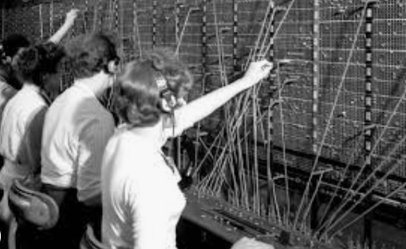
Image source: Internet

Slide 18
EMERGENCE: The Rise of the Telegraph and the Telephone
Telephone
The development of cell-based mobile phone services brings the near ubiquity of telephones in homes, businesses and reducing cost of calls.
The text messaging capabilities of pagers inspired mobile phone operating companies towards an accidental ‘killer application’ – short messaging service (SMS)

Slide 19

Image source: Internet

Slide 20
EMERGENCE: The Rise of the Telegraph and the Telephone
Telephone
With SMS, a culture of using abbreviation has grown up.
Issues:
Health risks from prolonged and regular use of mobile phones
Disturbance of sleep among teenagers and children because they do not switch off phones and disturbed by incoming calls or messages.
Phone alert in cinemas, theatres, lecture halls distracted others

Slide 21
EMERGENCE: THE RISE OF BROADCAST MEDIA

Slide 22
EMERGENCE: The Rise of Broadcast Media
The difference between printed media and broadcast media is similar to the difference between a letter and a telephone call.
Broadcast media were originally very heavily regulated in most countries.
Part of the reason for this was purely technical: analogue transmission requires a broad band of ‘clear space’ around it to prevent cross-channel interference.

Slide 23
EMERGENCE: The Rise of Broadcast Media
Although radio transmission and reception has improved over the more than a century since its introduction, such advances have been very small incremental changes: the basic technology remains pretty much the same
Only recently has broadcast digital radio become a reality; there has been a slow growth of both digital audio broadcast (DAB)
more people listen to digital radio channels via satellite television equipment

Slide 24
EMERGENCE: The Rise of Broadcast Media
Government: regulating broadcast technologies and artificially maintaining a scarcity of licenses by restricting the bandwidth available for such services

Slide 25
EMERGENCE: THE RISE OF THE COMPUTING INDUSTRY

Slide 26
EMERGENCE: The Rise of the Computing Industry
Machines for tabulating large amounts of statistical information
Machines for small number of other specialized tasks such as cryptography
Pharmaceutical industry use it to calculate efficient chemical supply logistics
First big killer application: airline ticket sales.
1970s - personal computer (PC)

Slide 27
EMERGENCE: The Rise of the Computing Industry
Social impact: Job Market
Programmer
Operator of complex machines (computers)
White-collar employment 🡪 must develop basic computer skills
New industry in personal and business computing training

Slide 28
EMERGENCE: The Rise of the Computing Industry
The difficulties of modern computing are often more about identifying the problem to which computer power can be applied, than in getting the computer to perform an understood task

Slide 29
EMERGENCE: THE RISE OF THE CONTENT INDUSTRY

Slide 30
Emergence: The Rise of the Content Industry
Since the Stationer’s Guild was granted a monopoly on the printing of books in the United Kingdom, there has been a significant commercial sector whose primary purpose is to act as the middle man between the producers and consumers of information

Slide 31
Emergence: The Rise of the Content Industry
Some revolutions:
New markets
Different producer and consumer relationships to different forms of content
Social effects of various technologies:
Amount
Varity
Accessibility
One-to-many, many-to-many communication

Slide 32
Emergence: The Rise of the Content Industry
Publication of books and films require more people with different skills. In order to supply the demand at affordable level, various compromises are made:
Law enforcement e.g. copyright
acceptance of advertisement during TV programmes

Slide 33
Emergence: The Rise of the Content Industry
Advertisement:
One of the method to fund television broadcast
In some TV programmes, advertising dictates the story format for TV shows.
Difference between made-for-television movies and mode-for-cinema movies is the obedience to advertising slots by providing mini-climaxes or cliffhangers to keep the viewer watching the programme through the advert break.

Slide 34
Emergence: The Rise of the Content Industry
Critics of the translation of stories between media:
Movie 🡪 novel (vice versa) 🡪 computer game
E.g. Spider-Man comics 🡪 Spider-Man cartoon TV show 🡪 Spider-Man novels 🡪 Spider-Man movie 🡪 Spider-Man computer games 🡪 back to comic-book adaptation of the movies
Which version is the original?
There are too many versions and re-interpretation

Slide 35
EMERGENCE: THE RISE OF THE INTERNET

Slide 36
Emergence: The Rise of the Internet
It has been in existence for over 30 years
Really emerged into the consciousness of the general public in the late 1990s

Slide 37
Emergence: The Rise of the Internet
One of the most successful dot com company to date is Amazon
Starting out as a US online book seller
it has been franchised out to various other countries, including
amazon.co.uk in the United Kingdom
amazon.de in Germany
amazon.co.jp in Japan
has branched out into providing various other types of goods, with a different mix for each country

Slide 38
Emergence: The Rise of the Internet
Airline agencies have also benefitted from the web
eTicketing performed completely online
eTicket – no physical ticket printed only an online version

Slide 39
Emergence: The Rise of the Internet
Online Auction: make use of the many-to-many nature of the web
Biggest asset: system of trust
Buyer knows he/she will receive product
Seller knows he/she will get paid
eBay provides a mechanism for trusting other sellers without paying for expensive escrow payment and delivery systems (i.e. the cash-on-delivery service)
Rating service derived from previous transactions

Slide 40
Emergence: The Rise of the Internet
Non-Ebay auction systems tend to have a minimum fee which militates against their usage for low-value items
eBay's control mechanisms
dependent on identification via physical address
bank and credit card accounts
-> are sufficient to prevent all but the most dedicated serial fraudster

Slide 41
CONVERGENCE: CONTENT PRODUCERS AND DISTRIBUTORS

Slide 42
Convergence: Content Producers and Distributors
Example of convergence: content production and distribution companies
Companies that produce content for TV(Web) and the TV stations(ISP) themselves
Government tries to prevent the merge if it forms a monopoly

Slide 43
Convergence: Content Producers and Distributors
In previous decades, many Western countries have had strong regulation covering ownership of multiple channels of information dissemination but this has recently been relaxed

Slide 44
CONVERGENCE: PLATFORM PRODUCERS & CONTENT PRODUCERS/PUBLISHERS

Slide 45
Convergence: Platform producers & Content Producers/Publishers
Video game production is very costly and quite a risky business – as risky as making movies.
Console manufacturers allow & encourage, third-party publishers and developers to create games for their consoles
In order to maintain the revenue stream from games, they require publishers to submit their games through quality assurance tests run by the manufacturer and to pay a licensing fee in order to get appropriate encryption codes which allow their games to be loaded onto the consoles

Slide 46
Convergence: Platform producers & Content Producers/Publishers
some remaining tensions: since manufacturers are also developers and publishers of their own games, the quality-control process, being used to gain an advantage in the games market, particularly where similar games are due to be released by both the manufacturer and a third-party developer around the same time
In fact, the computer games industry now grosses more revenue than cinema

Slide 47
CONVERGENCE: CORPORATE PRODUCTION VS INDIVIDUAL CREATIVITY

Slide 48
Convergence: Corporate Production vs Individual Creativity
Early days: right ideas can become major players very quickly
E.g. music publishing industry: player-piano-roll makers
E.g. movie-making industry: MGM, Paramount, United Artists.
However, these industry needs large investments of capital at the beginning in order to succeed

Slide 49
Convergence: Corporate Production vs Individual Creativity
Computer-games industry:
Do not require large capitalization as movie-making industry
Started in the early days by individuals during their spare time and now are still big names, e.g. Ultima 🡪 Massively Multiplayer Online Role-playing Game (MMORPG)
However, in the modern mature games market, entry to the market by individual is almost impossible. Reasons: gamers expect top quality in all aspects of the games, from story to interaction to graphics.

Slide 50
Convergence: Corporate Production vs Individual Creativity
Computer-games industry:
Therefore, in the modern mature games market, only the big games publishers survive.
Today, mobile phones evolution gives individuals opportunity to start small scale development as mobile phones currently enjoy a similar level of graphics to the early computer games.

Slide 51
Convergence: Corporate Production vs Individual Creativity
New distribution channels (convergence between handheld technology, TV, home computer & other entertainment systems) lead to an advantage for smaller development-oriented firms providing new content for existing software platforms.
New business model: engine-content split
E.g. editors for various games to ‘update’ game packs allowing gamers to release their own extra levels.

Slide 52
CONVERGENCE: MARKET SECTOR INTEGRATION, HORIZONTAL AND VERTICAL INTEGRATION

Slide 53
Convergence: Market Sector Integration
Companies frequently seek to expand profits by moving into other areas (normally related fields)
E.g. Microsoft moves into:
video game console market with Xbox
Mobile-phone-cum PDA world
Home entertainment electronic market: to put standard PC running Microsoft software in an integrated TV-DVD-audio entertainment system

Slide 54
Convergence: Market Sector Integration
In some cases, it can be more difficult for a large organization rooted in one field to move into a new field than for an entirely new enterprise to enter that same market.
This is due to organizational inertia and mistaken expectations within the original company.

Slide 55
Convergence: Market Sector Integration
Other successful market sector integration:
Google emerging into the access provision field with their municipal WiFi contract with the city of San Francisco, CA, United States.
Nestlé, original business was based on milk and dietetic foods for children, grew and diversified its markets into: LACTOGEN (1921), MILO (1921), NESCAFE (1938), MAGGI (1947), etc.
Genting Berhad, starting up with Genting Highlands Resorts, grew intro plantation, power generation, oil and gas exploration and production.

Slide 56
Convergence: Market Sector Integration
One option to enter a mature market is to buy an existing player in the market
This is true especially in the multimedia content production and distribution industries.

Slide 57

Convergence: Market Sector Integration
E.g. Warner Bros
Bought Vitagraph Company which had a nation-wide distribution system.
Bought First National screenwriter (1929) with government regulation that:
two companies must maintained separately until 1930s.
Warner Bros must produce few films each year under the First National name until 1938.
Bought Schlesinger’s cartoon (1944) and renamed it Warner Bros. Cartoons
Bought Turner Broadcasting System (1995)
Etc.

Slide 58
Convergence: Horizontal Integration
Reduces the number of players in a marketplace or merges two related marketplaces.
Example:
merger between Celcom Axiata Bhd and Digi
IBM computer division acquired by Lenovo

Slide 59
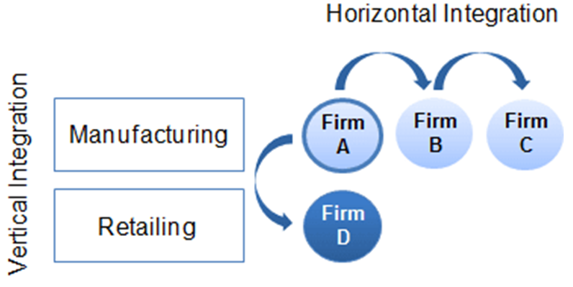

Slide 60
Convergence: Vertical Integration
Reduces the number of steps in the chain from raw material to eventual consumer to gain control over their industry’s value chain.
Example:
Samsung is manufacturing OLED for its smart phones
Apple is having its own retail stores for selling its products

Slide 61
Advantages of Vertical Integration
Simple way to avoid transaction costs is to merge with a supplier
Very effective where the supplying and consuming businesses deal solely or primarily with each other and do not ‘play the field’
Quality control is another reason for consumers to merge with suppliers

Slide 62
Disadvantages of Vertical Integration
Biggest internal problems such mergers produce are management problems in combining businesses which had completely different goals up to the merge
Leads to a ‘local optimization’ problem where existing structures (particularly the two formerly separate organizations) still try to maximize their separate benefits instead of global optimization for the company

Slide 63
CONVERGENCE: DIGITIZATION

Slide 64
Convergence: Digitization
From analogue technology to digital technology
Digitization vs Digitalization vs Digital Transformation?

Slide 65
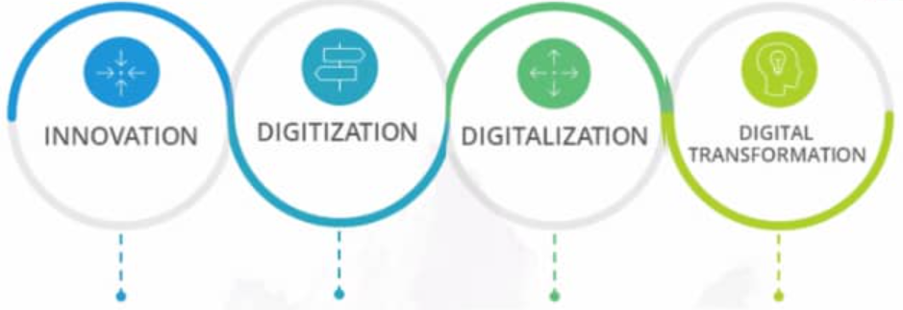
Process of creating value by doing things better
Converting analog information into digital format
Use of digital technologies to change a business model and provide new revenue and value-producing opportunities
A journey of strategically planned organizational change to dominate or stay relevant in a competitive market place by leveraging disruptive technologies

Slide 66
Convergence: Digitization – Mobile Phones
First generation: analogue
Second generation: digital
Third generation: high-speed data transmission

Slide 67
Convergence: Digitization – Mobile Phones
Advantages:
Less power to broadcast and receive signals
Thus smaller in size, longer standby and connection times, wide areas coverage, increasing density of maximum number of connections within same area
Digital signals can contain error-correction elements
Smaller aerials
Digital signals can be encrypted easily using public-key encryption protocols 🡪 avoid eavesdrop

Slide 68
Convergence: Digitization – Mobile Phones
Disadvantages:
Mobile phone infrastructure (transceiver stations) is very expensive to install
Existing company has to maintain both analogue and digital services
New entrants need high investment in infrastructure
Customers faced cost in upgrading handsets
Solution: operating companies offered digital handsets at subsidized prices (or free)
Replacing still working phones produces waste electrical products
Solution: recycling of working handsets to developing nations

Slide 69
Convergence: Digitization – Television
Three main methods of broadcasting a TV signal, each of which has both a digital and an analogue version:
Terrestrial broadcast
Cable delivery
Satellite broadcast

Slide 70
Convergence: Digitization – Television
Advantages
Error correction for higher quality transmission at lower power:
Lower power: the range of options (how many channels you can receive) is possible and important in a one-to-many broadcast system
Potential for encryption of digital broadcast
Wide variety of services:
Multiple channel availability
Subscription-based services

Slide 71
Convergence: Digitization – Television
Disadvantages
Significant investment in new transmission and reception technologies.
Multiple channels availability means the needs of wide resources of production companies
Advertising for targeted channels becomes lower due to the reduced number of viewers.

Slide 72
Convergence: Digitization – Television
Disadvantages
TV-based access to the Internet through set-top boxes turned out to be limited:
The resolution of TV screens is not sufficient for much of the Web content
Those used to using the Internet through computer have not changed their usage
Those not used to the Internet found that it is not easy to use the limited TV Internet

Slide 73
Convergence: Digitization – Television
Digital TV broadcast in Malaysia began in the mid-1990s with the introduction of Astro satellite TV service.
Digital terrestrial TV started in 2005 to digitalize nationwide free-to-air TV broadcast led by Radio Televisyen Malaysia (RTM)
Analogue TV broadcast would have been shut down in stages, due to complete by 2015.
High-definition TV (HDTV) trials in 2008 – Beijing Olympic Games
2009, Astro Beyond – HDTV service.

Slide 74
Convergence: Digitization – Music Publishing
Started with the adoption of the compact disc digital audio standard for music
Extremely successful move – generating new revenues for publishers as consumers replaced their old vinyl with the new digital medium

Slide 75

Convergence: Digitization – Music Publishing
Advantages
Better sound (although the truth is vinyl records actually have higher quality output than compact discs)
Smaller size and less fragility
Cheap CD players produce better quality output than cheap vinyl record players
CD contain significantly more music and no loss of quality compare to vinyl record

Slide 76
Convergence: Digitization – Music Publishing
Disadvantages
Replacement cost of both the medium and the player
Music industry loss:
Everyone could copy CDs and pass around as perfect copies to friends
Introduction of MP3 format (small size) can be downloadable even at dial-up connection speeds over the Internet

Slide 77
Convergence: Digitization – Music Publishing
Disadvantages
Replacement cost of both the medium and the player
Music industry loss:
Everyone could copy CDs and pass around as perfect copies to friends
Introduction of MP3 format (small size) can be downloadable even at dial-up connection speeds over the Internet

Slide 78
THE BIG CHALLENGES AHEAD

Slide 79
The Big Challenges Ahead
Technological changes almost always prompt social and economic changes as well.
E.g. the Internet allows small local businesses to compete with multinational companies.
E.g. the world is getting bigger and smaller.
The speed of technological change is still increasing
Economic decisions influenced by major technological developments are becoming more and more risky.

Slide 80
The Big Challenges Ahead
Social pressures due to technology are becoming the subject of major policy debates and public lobbying
privacy
content control
Intellectual property rights (copyright, patent, etc)
It is more possible for the few may control the many than at any other time in history
Will the technologies lead to freedom, respect and democracy is still a big question.

